Slide 1

Accord events & services
Jharkhand ,Bihar ,Orissa & Chhattisgarh

Slide 2
Accord Events & Services
Accord Events & Services is full services marketing consultancy firm operating in Northeast zone of India. We are strategic marketing consultancy whose purpose is to provide best quality of services to our client and help business owners and managers to achieve their marketing and business development objectives. We work successfully with a wide range of clients across country all over Jharkhand & Bihar including small to medium sized business to corporate behemoths. Working in the local environment gives us an in-depth insight into the local market dynamics allowing us to formulate effective marketing strategies. This results show as our clients achieve their objectives from growing revenue and profitability to improving communication and engagement.
Director
Sheoraj kumar

Slide 3
OUR SERVICES 1)BTL Promotion:-Road Shows, Rural Area Marketing, Mall Activity, On Door Promotion, Bike Road Show, School/College Activity ,In Shop Promotion, Wall Painting, Shop Merchandising. 2)Corporate Affairs :-Product Launching, Dealers Meet, Media Events, Inaugurations, Get Together, Seminars/Meeting, Sales Kick off Events, Training Seminar, Exhibition. 3) Production House :-Stage, Sound System, Light System, DJ Equipments, Back Projection/Screen, Plasma TV/LED Wall, Laptop, Photographer /videographer, Generators, Iron Frame. 4)Customize Evening :-Theme Parties, Gala Dinner, Anniversary Bashes, Birthday Parties, Designer Wedding, Picnic Parties. 5)Entertainment Live :-Music Concert, Stage Show, Award Night, Star Night, Fashion Show, Singer , Dancer, Anchor, Comedian, Magician

Slide 4
Live music & gala night
Jharkhand & Bihar

Slide 5
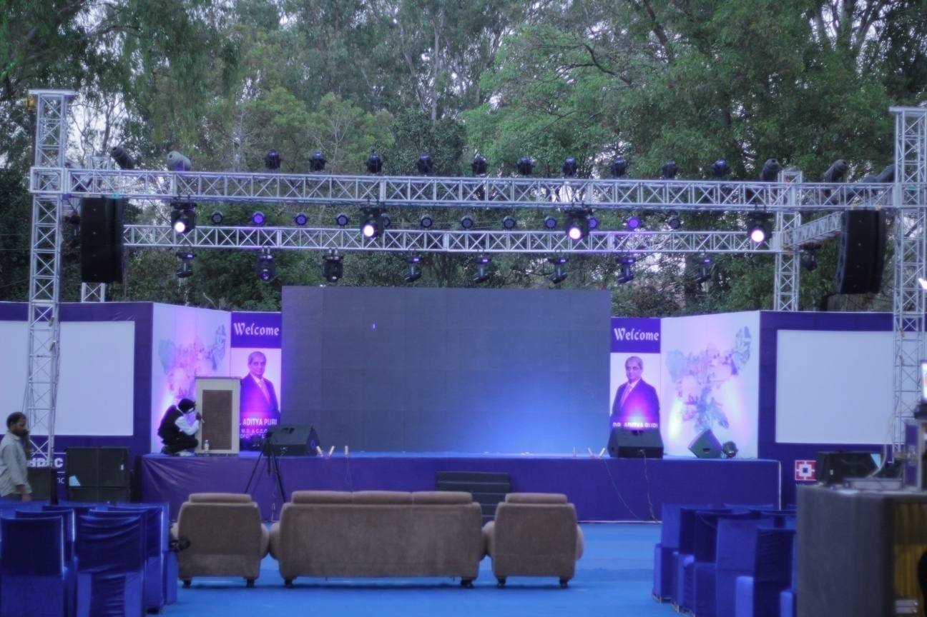
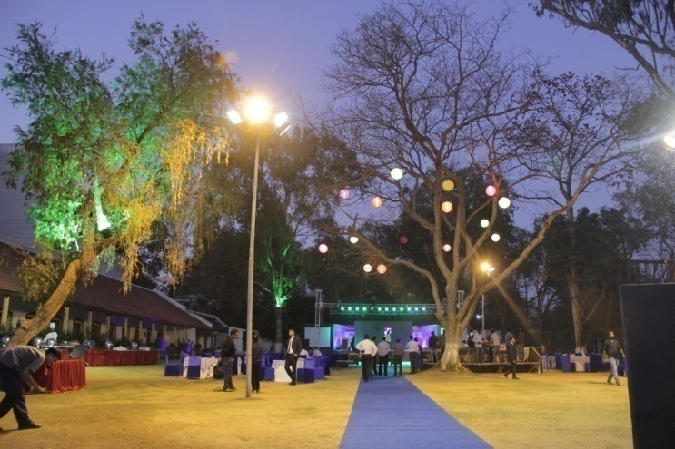
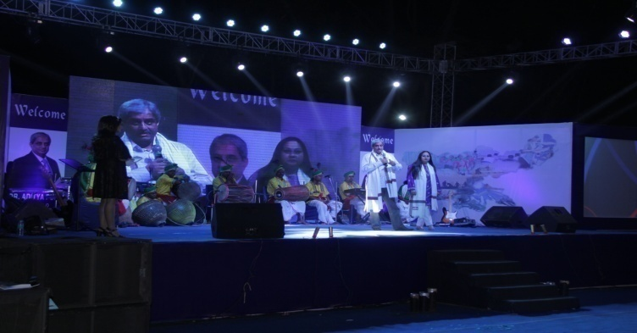
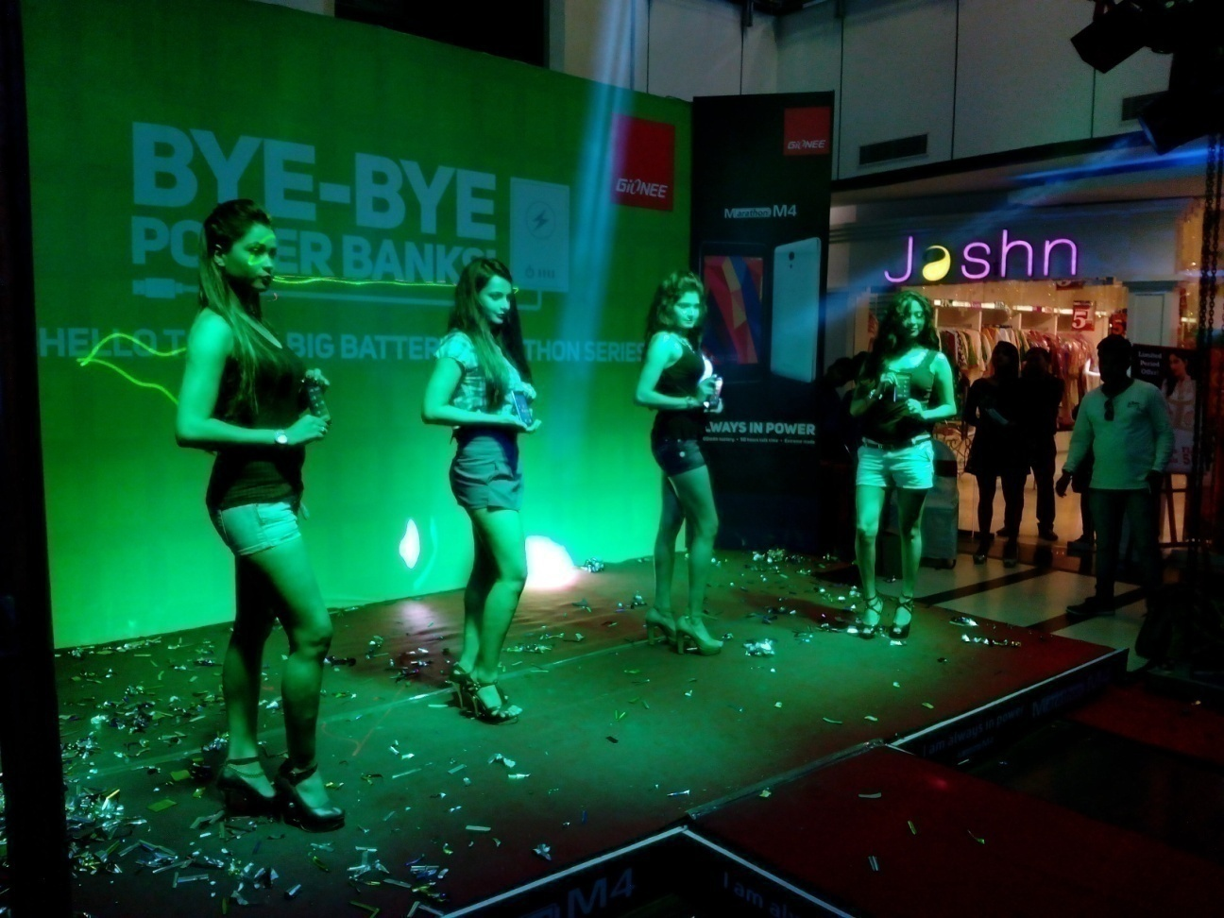
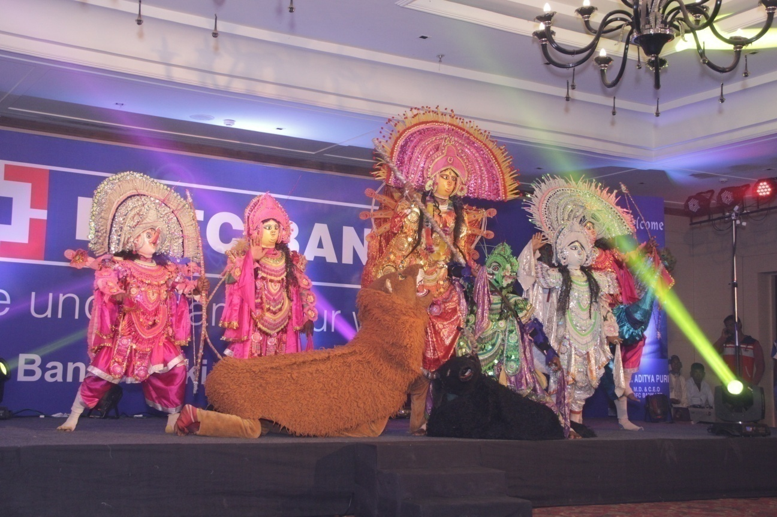
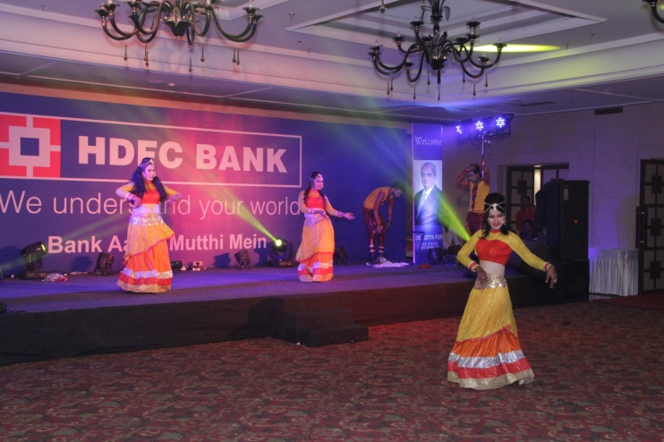
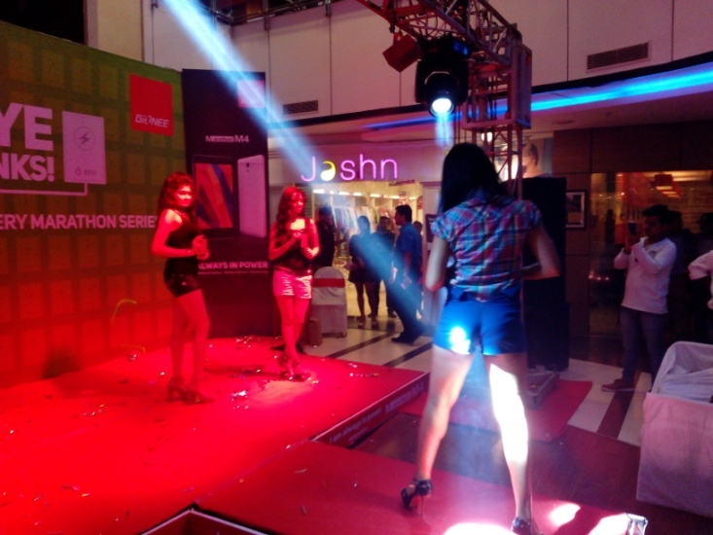
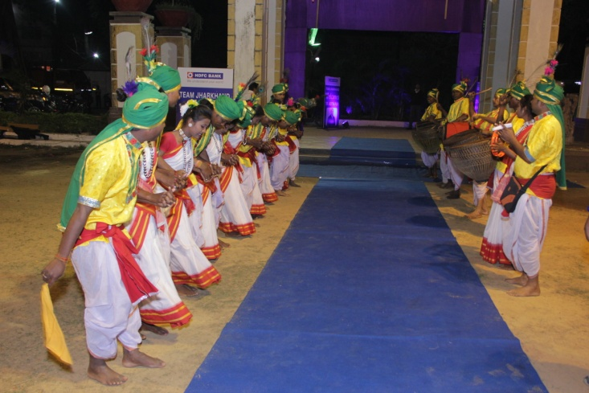
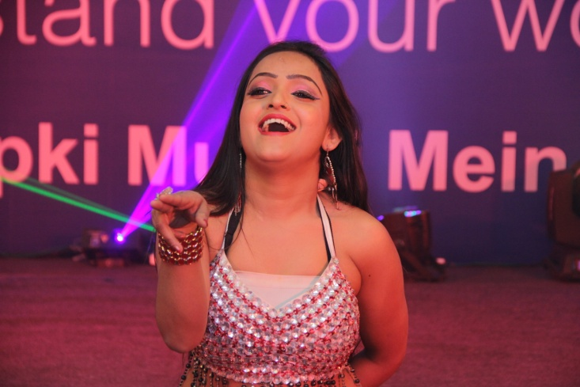
Accord events & services
www.accordevents1.com

Slide 6
Dealers meet & seminars
RANCHI & JAMSHEDPUR

Slide 7
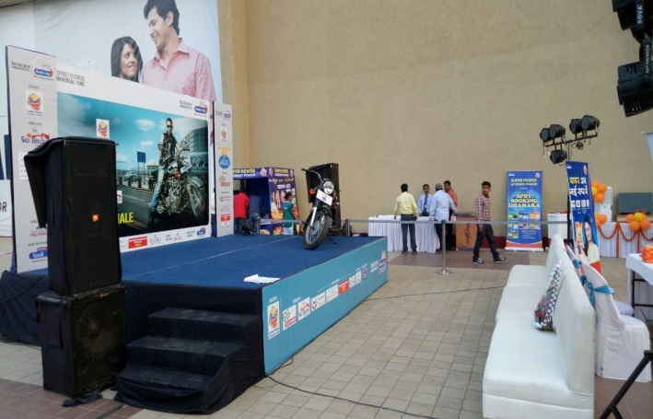
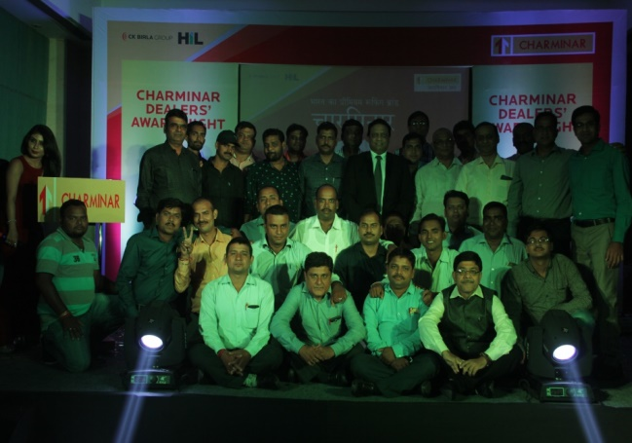
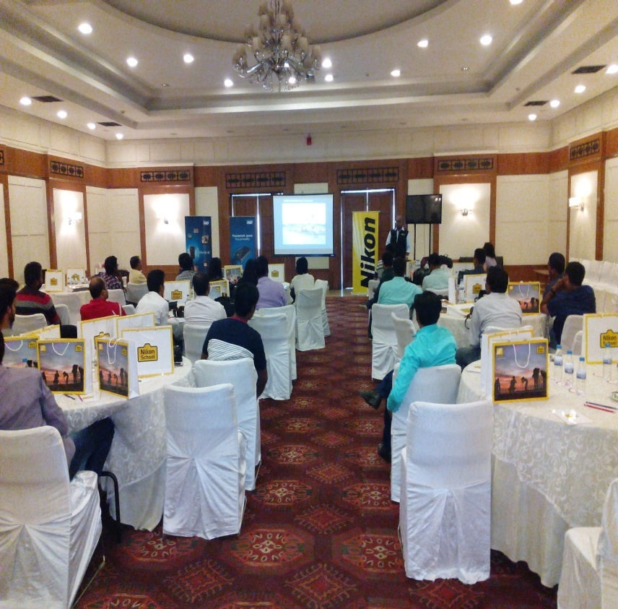
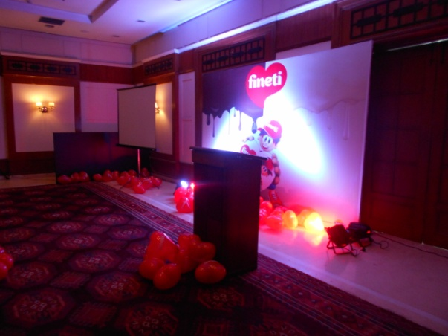
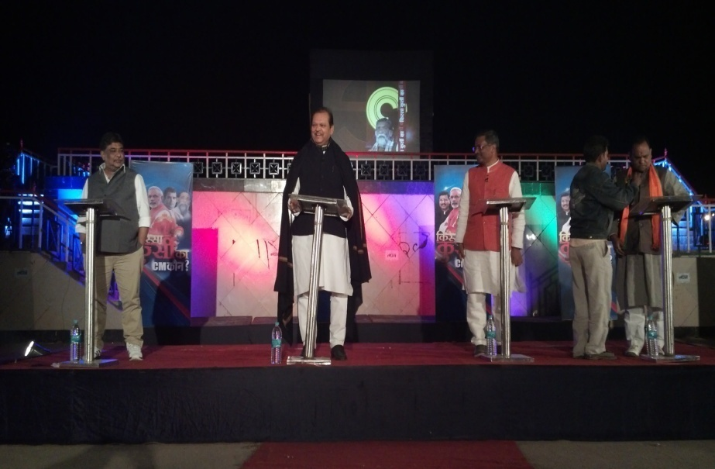
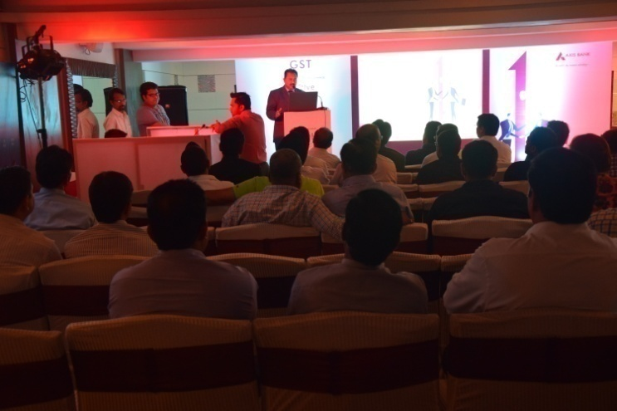
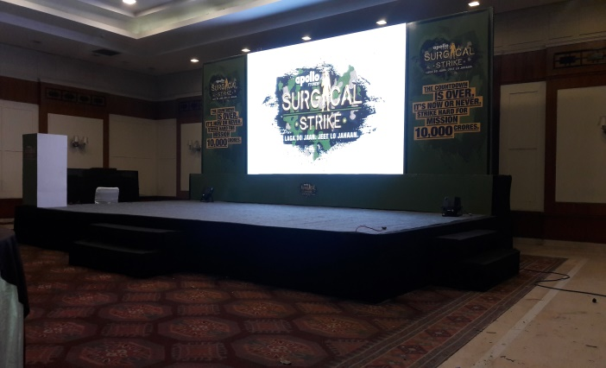
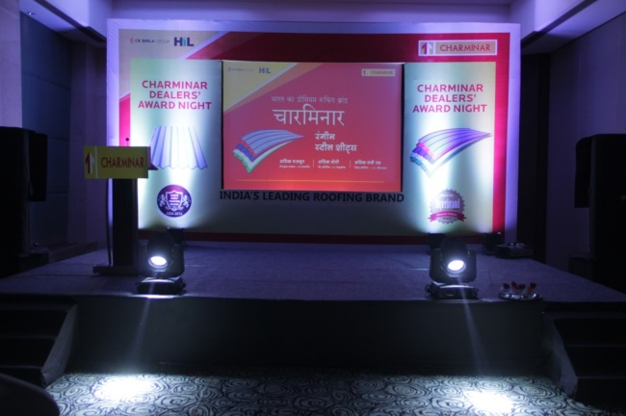
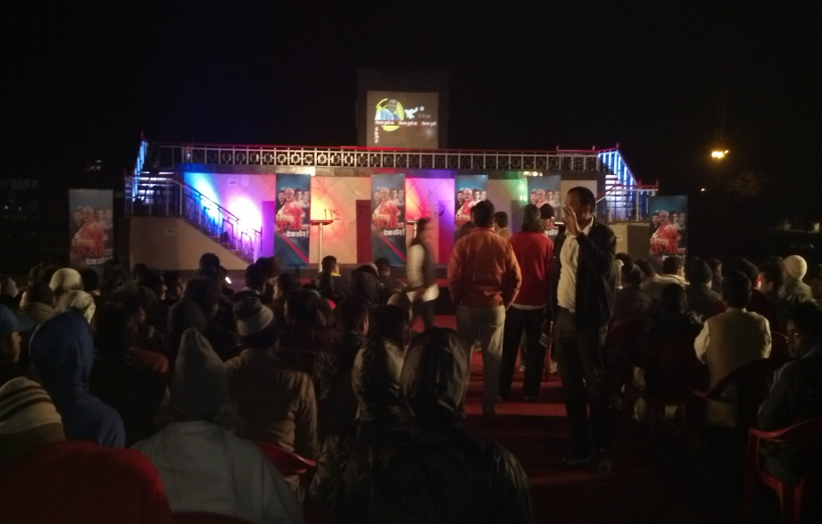
Accord events & services
www.accordevents1.com

Slide 8
Road Shows & stunts
Jharkhand & Bihar

Slide 9
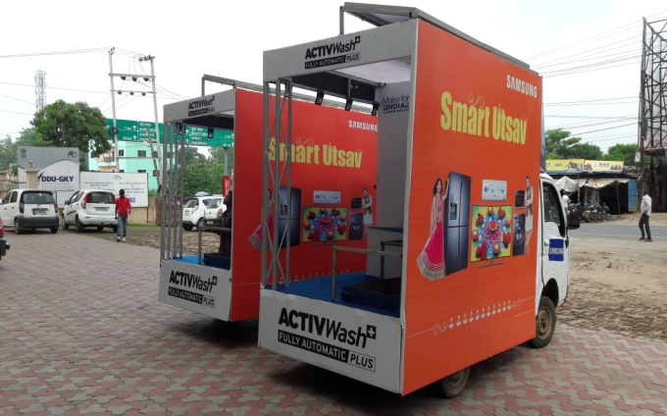
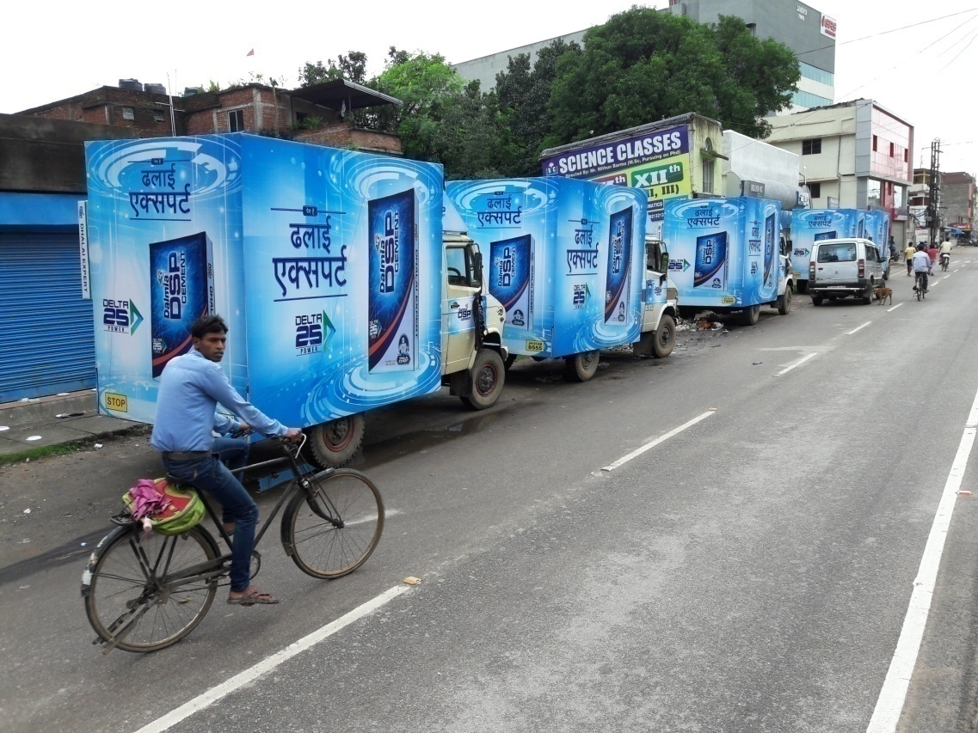
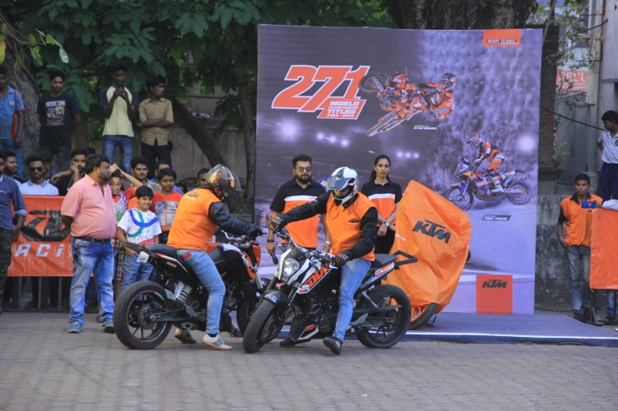
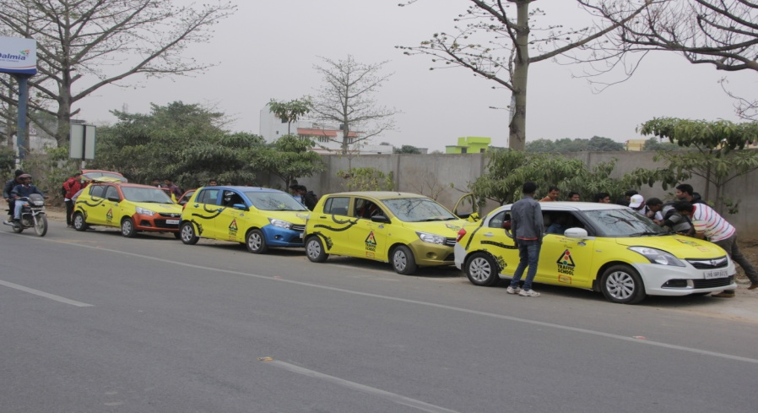
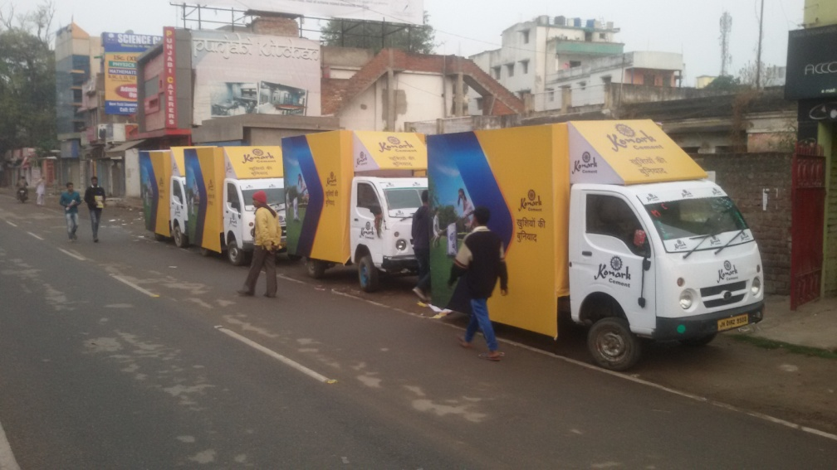
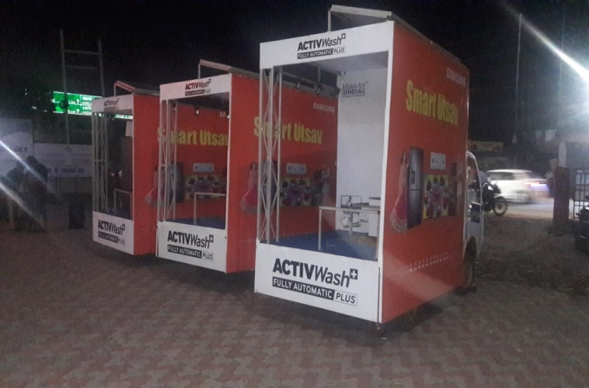
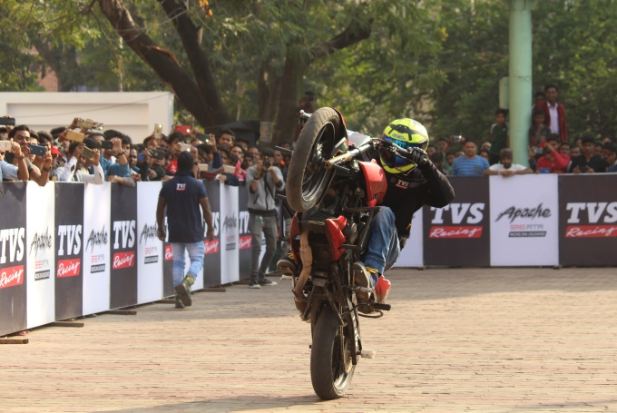
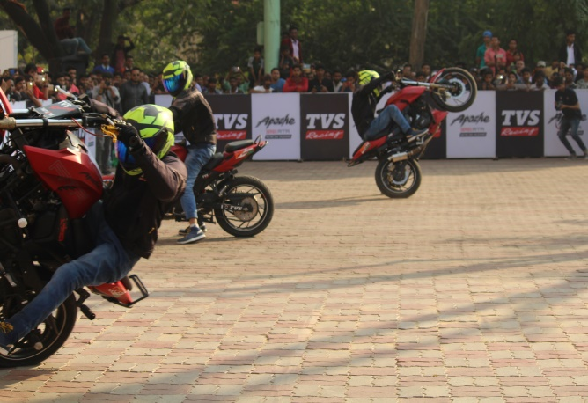
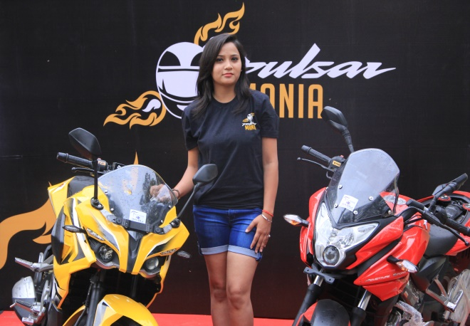
I

Slide 10
BTL & MALL PROMOTION
Jharkhand & Bihar

Slide 11
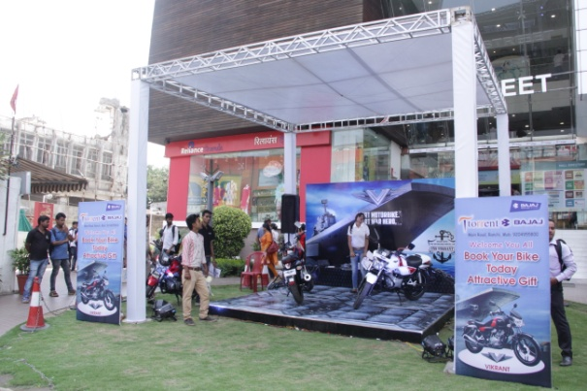
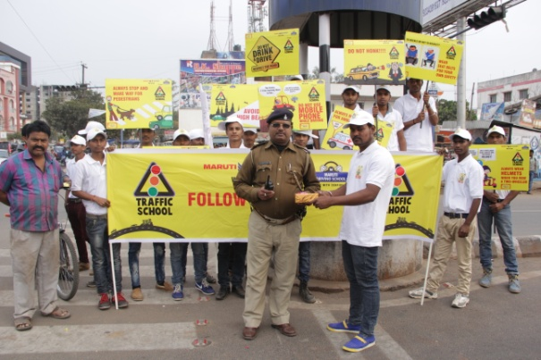
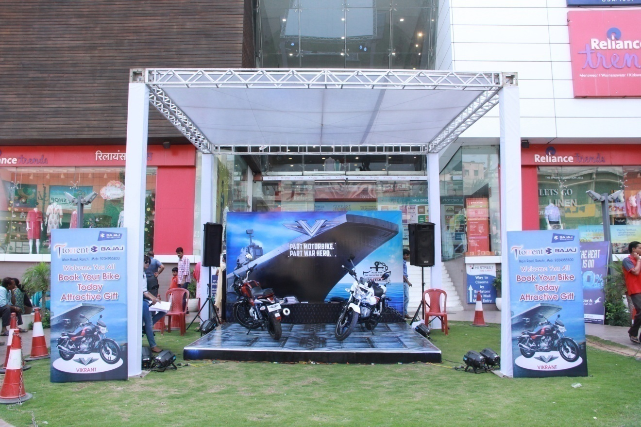
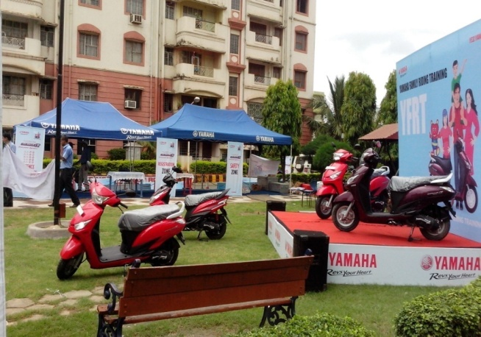
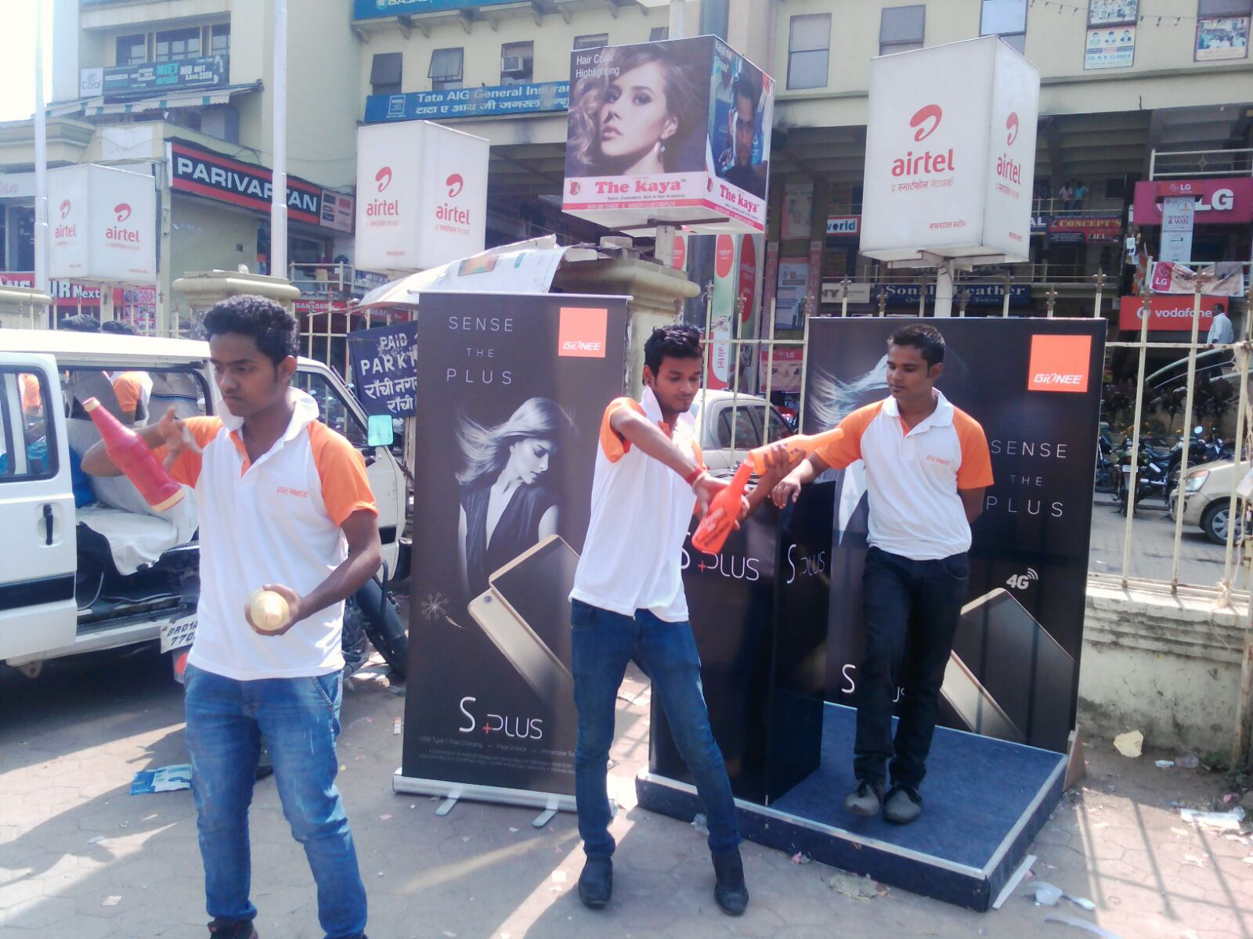
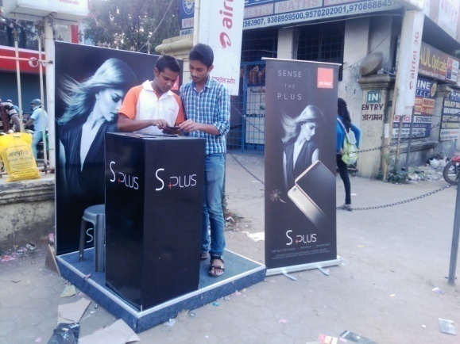
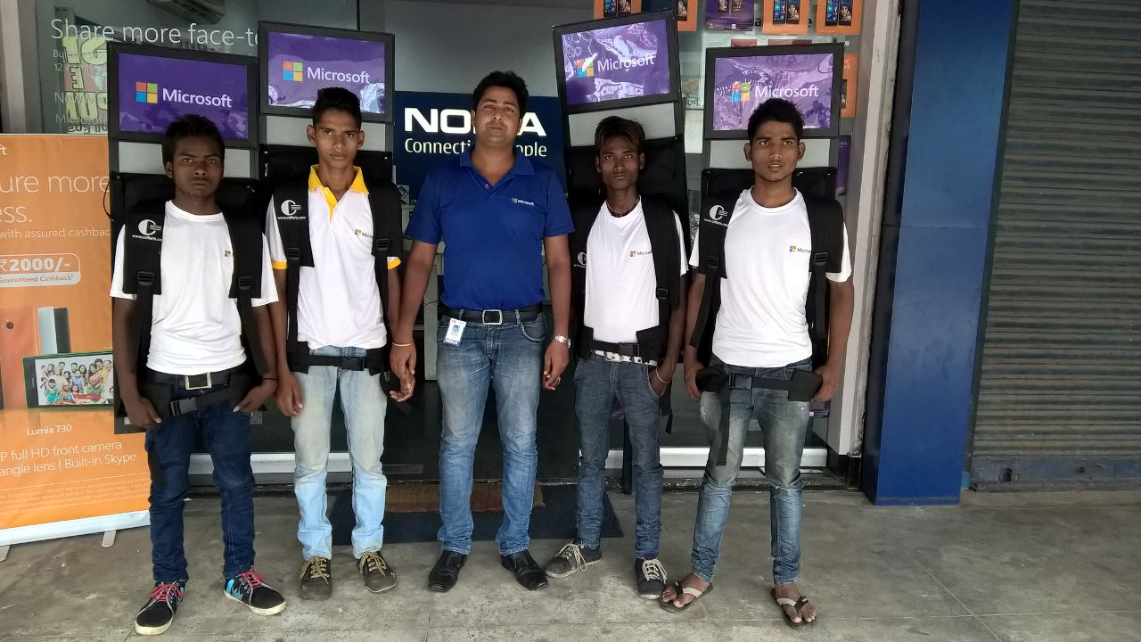
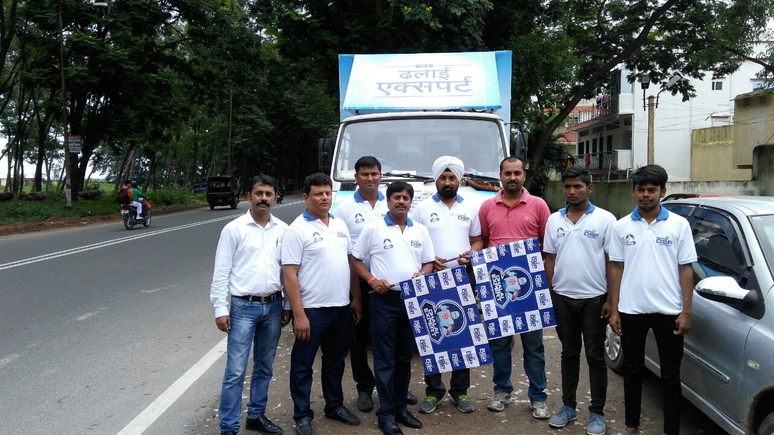
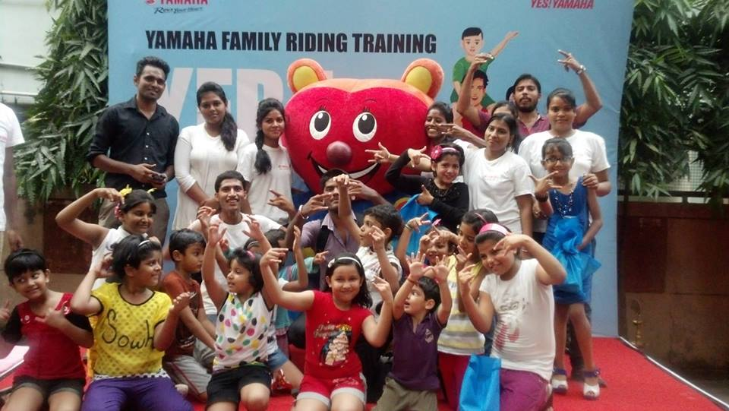
I

Slide 12
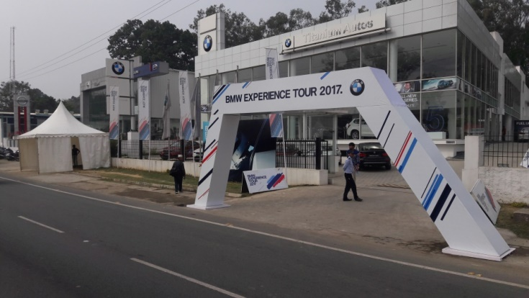
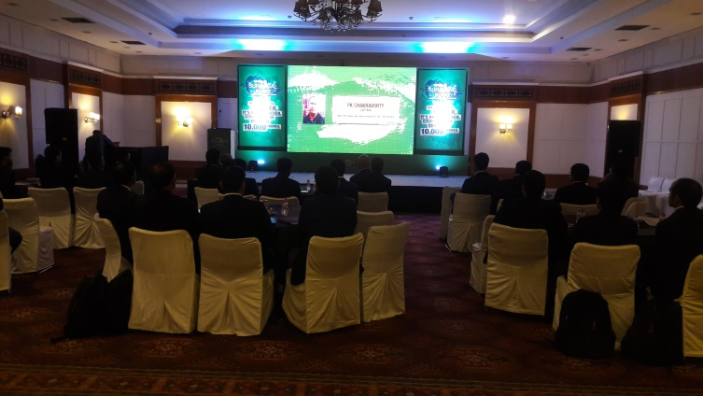
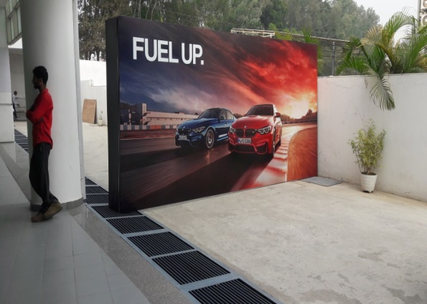
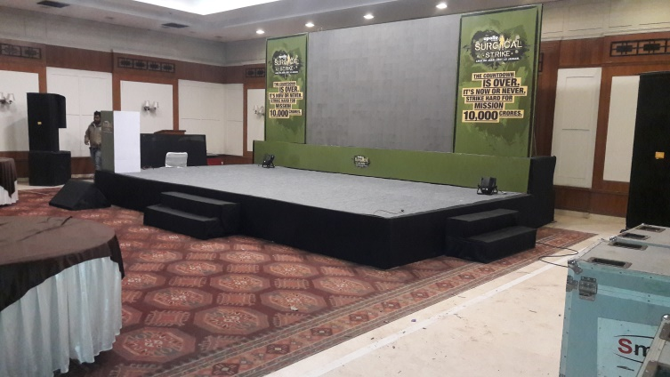
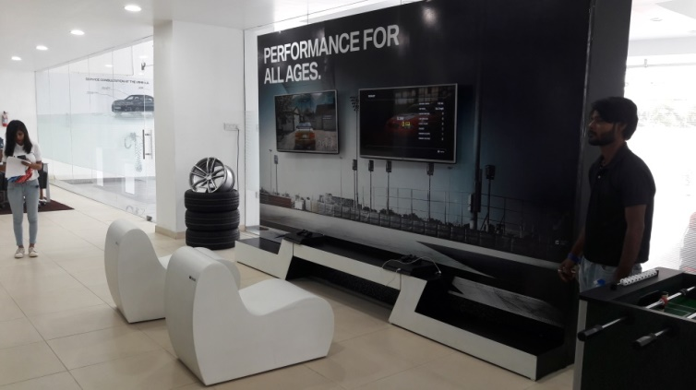
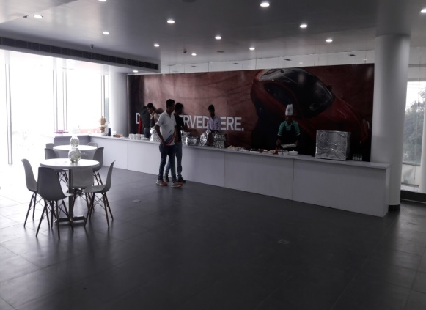
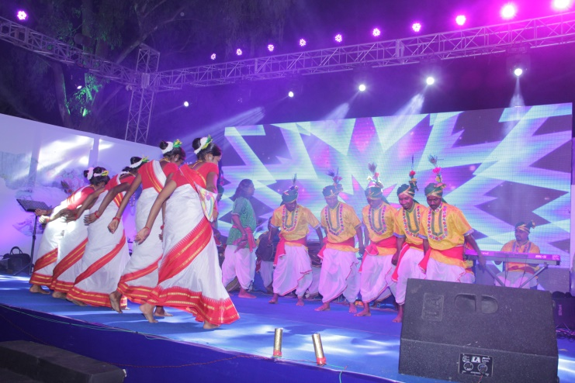
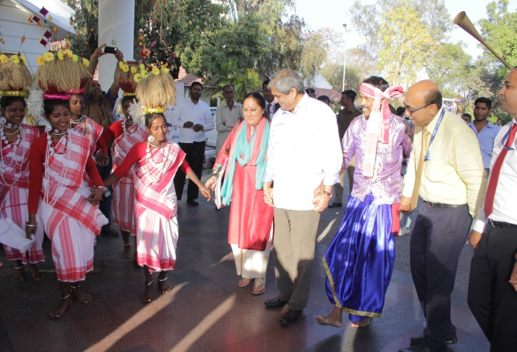

Accord events & services
www.accordevents1.com

Slide 13
Contact detail
Mob :- 09304454283, 07004518377,
Email id :- sheorajkumar@accordevents.org,
team@accordevents.org
Website:- www.accordevents1.com

Slide 14

Thank you www.accordevents1.com
Thank you

